Slide 1
Human Biology – Chapter 2 Lecture Notes Chemistry of Life

Slide 2
Notecard assignment
On your notecard, please list:
First and last name. If you have a nickname, please put it in “” after your name
Major, minor (or concentration)
Classification (Fr2, Sr1, etc.)
Hobbies
Organizations you’re a part of here
Your co-op employer and laymen’s terms job description
Scan the syllabus (or share with a neighbor)—what topic interests you most and why?
What topic for this class are you less interested in?
Once you have completed this, please get into a group of 4-5, look at the syllabus, and formulate any questions over the syllabus, the course, or about me (research interests, background, etc).

Slide 3
Suggestions for How to Get an ‘A’ in Biology Classes
Prepare for class by reading the book (12th or 13th ed.) before each lecture.
Read learning outcomes.
Look at all pictures/diagrams and read legends.
Read all boldfaced terms and mark definitions.
Read the summarize section at the end of the chapter.
Come to class on time and participate.
Bring your printed slides with space beside to take notes or outline. (Alternative: laptop or bring textbook and take notes alongside pictures. Please don’t print from the Mott 3rd Floor Student Lounge)
Star anything that didn’t make sense in class. Come back to it later. Actively engage with material (highlight/FIB).

Slide 4
Suggestions for How to Get an ‘A’ in Biology Classes, Cont’d
At the end of each class day, re-read notes from class and make a topical outline of slides to review concepts. DRAW YOUR OWN PICTURES of tissues and body systems.
Find a study partner and share chapter outlining responsibilities. Teach it to each other. Try to anticipate my questions (consider both the details and the big picture)
Consider getting an A&P coloring book if you have trouble remembering body systems and directions of flow.
DO NOT PROCRASTINATE!

Slide 5
BIOLOGY - The Study of Life
All living things share 7 basic properties:
Growth
Cellular Organization
Response to Stimuli
Homeostasis
Adaptations
Reproduction
Metabolism (Energy transformation)
Notes:
Organization: cells, tissues, organs, etc. Metabolism: has chemical reactions, use materials and energy

Slide 6
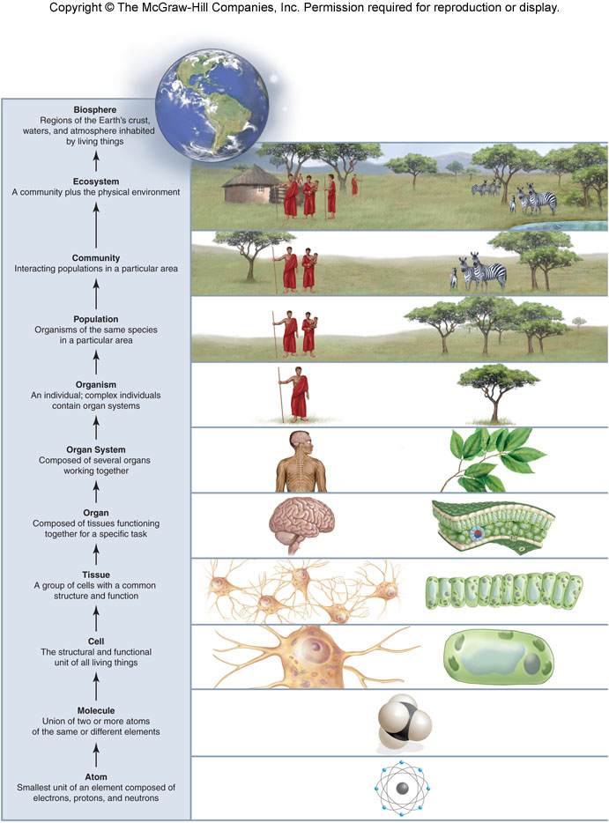
Organization of Life

Slide 7
Learning Outcomes, Chapter 2
2.1 From Atoms to Molecules
1. Distinguish between atoms and elements.
2. Illustrate the structure of an atom.
3. Define an isotope and summarize its application in both medicine and biology.
4. Distinguish between ionic and covalent bonds.
2.2 Water and Living Things
1. Describe how hydrogen bonds are formed.
2. List the properties of water.
3. Summarize the structure of the pH scale and the importance of buffers to biological systems.
2.3 Molecules of Life
1. List the four classes of organic molecules that are found in cells.
2. Describe the process by which the organic molecules are assembled and disassembled.

Slide 8
Learning Outcomes, Chapter 2
2.4 Carbohydrates
1. Summarize the basic chemical properties of a carbohydrate.
2. State the roles of carbohydrates in human physiology.
3. Compare the structure of simple and complex carbohydrates.
4. Explain the importance of fiber in the diet.
2.5 Lipids
1. Compare the structure of fats, phospholipids, and steroids.
2. State the function of each class of lipids.
2.6 Proteins
1. Describe the structure of an amino acid.
2. Explain how amino acids are combined to form proteins.
3. Summarize the four levels of protein structure.
2.7 Nucleic Acids
1. Explain the difference between RNA and DNA.
2. Summarize the role of ATP in cellular reactions.

Slide 9
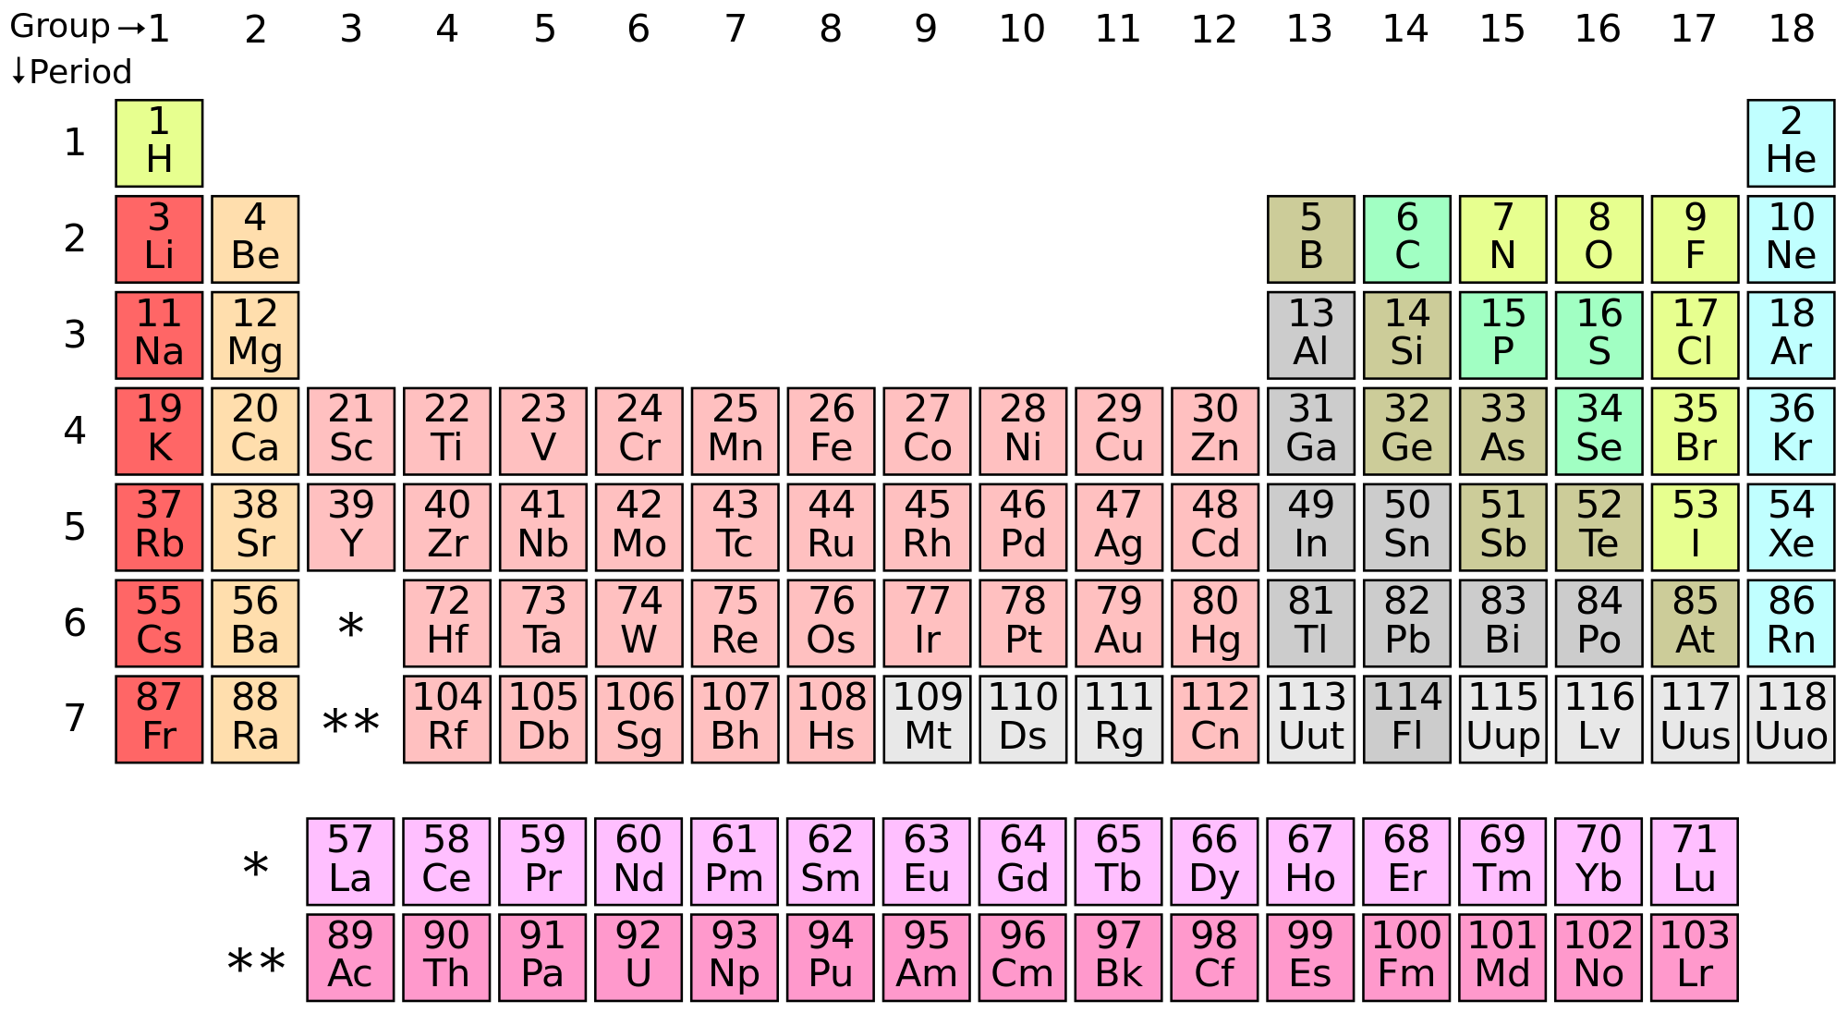
The Periodic Table

Slide 10
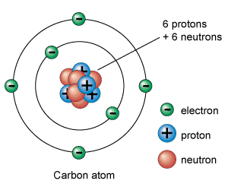
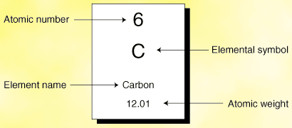
Review of Basic Chemistry Terms

Slide 11
Properties of Water (2.2)
Water is the most abundant molecule in living organisms (60-70% total body weight)
Water is Life’s Solvent
This is true due to its unique properties:
Water is a polar molecule.
Water molecules interact via an ideal hydrogen bonding arrangement.
Water is cohesive.
The temperature of liquid water rises and falls slowly.

Slide 12
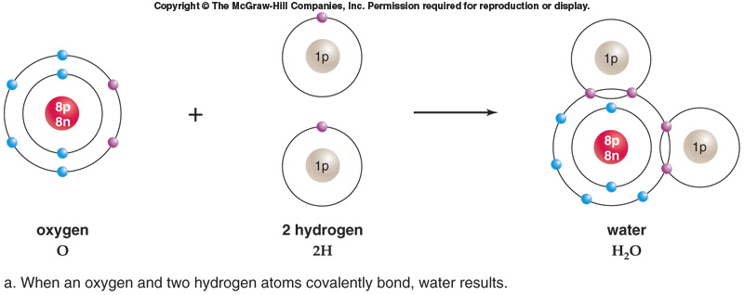
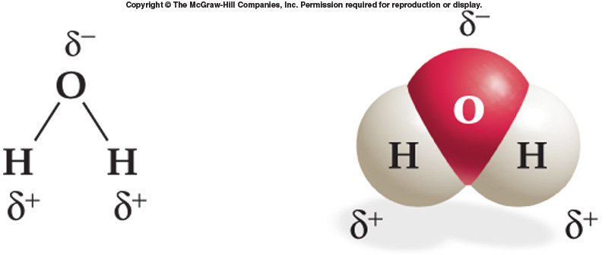
Fig 2.6
Fig 2.7A

Slide 13
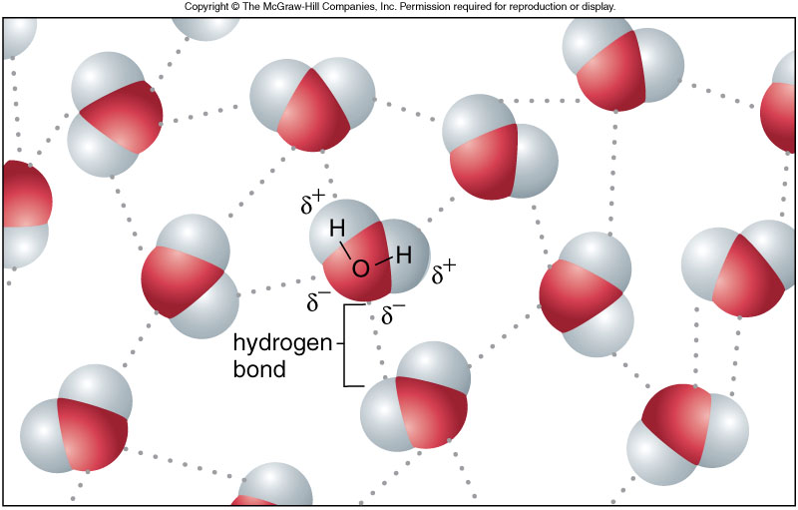
Hydrogen Bonding and Dipole Moments of Water Molecules

Slide 14
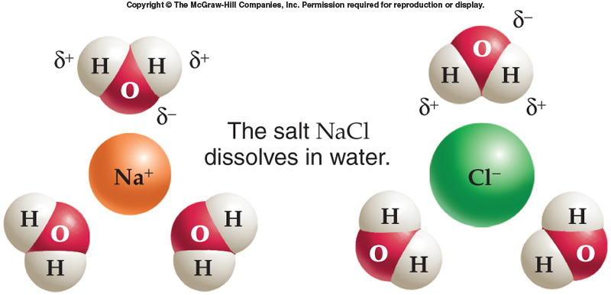
Water Is a Good Solvent
Fig 2.8b

Slide 15

Acid and Base Properties of Water
Fig 2.9b

Slide 16
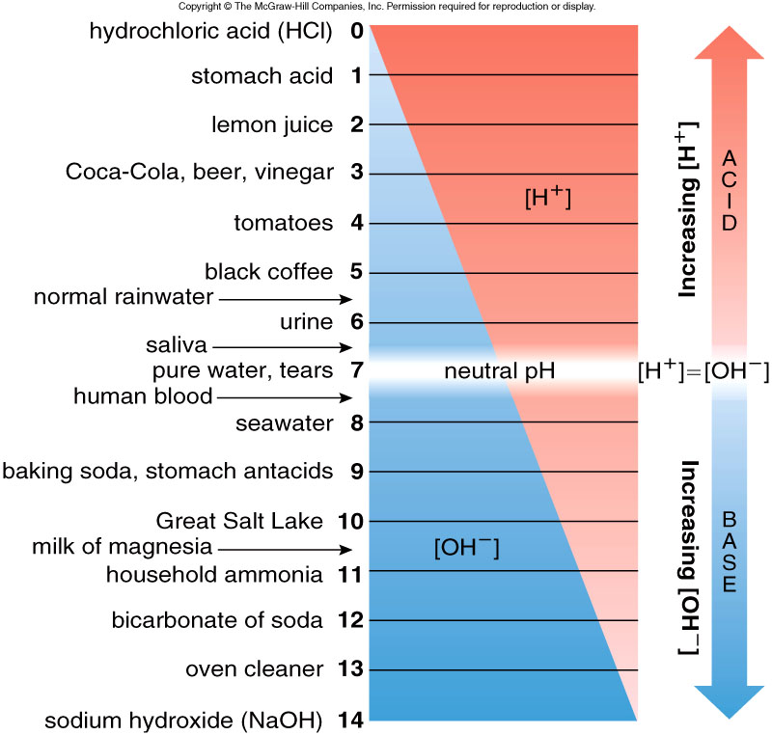
Figure 2.8
Fig 2.10

Slide 17
Buffers
Buffers maintain pH within a narrow range.
This is essential for biological reactions.
A buffer consists of a weak acid and its conjugate base (or vice versa).

Slide 18
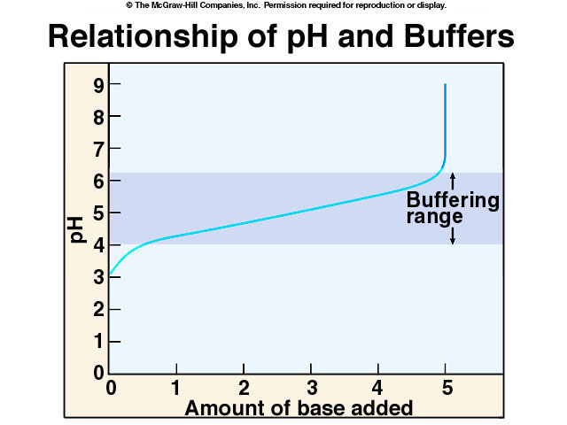
Not in text

Slide 19
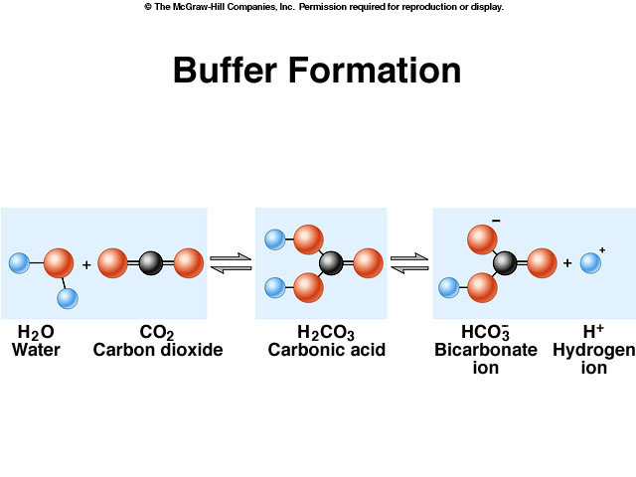
Buffering System in Blood

Slide 20
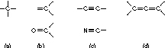
Organic Chemistry
“The Study of Carbon Compounds”
Alkyne
Alkene
Carbonyl
Imine
Not in text

Slide 21
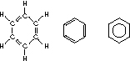
Review of Organic Chemistry
-structural representations of benzene
Not in text

Slide 22
Slide before break
Brainstorm for a few minutes:
How does a person know if they are healthy? What are some of the factors of health that can be assessed?
How does a person know if they are getting the proper nutrients?
What is a healthy diet?
How do you distinguish between a fad diet and a legitimate diet?
Do you have a fad diet that you'd like to check out? Name at least 3-4 that you have heard about.

Slide 23
Segue into macromolecules
At the end of this chapter, and in lab this week, we’ll focus on nutrition. I am asking you to form groups of 3-4 and develop a presentation on a diet of interest to your group. You will present your diet topics starting this Thursday, continuing next week as needed.
This is worth two group quiz grades, so make sure your presentations are full of pictures, that they are from reliable sources (include your references), that they answer the key points on the next slide with more pictures than words, that you speak clearly and loudly, and that you pull your own weight—your involvement will be rated by your group members, and you are judged on your portion of the presentation.

Slide 24
Diet Presentation Key Points
Please answer the following questions in your presentation and divide up questions equally in your groups. :
For this group project, you must research the following topics (posted on Blackboard): 1. What foods can one eat on this diet? Is there a variety? 2. What foods are to be avoided? 3. Does one have to buy special products or equipment while on this diet?/ Is it expensive? Is it hard to obtain the items needed for the diet? 4. How much time would one need to spend in preparation of the foods for this diet? 5. Find 3-5 restaurants which serve food that would fall on this diet here in Flint, and tell what could be eaten on the menu that supports that diet. 6. What could you eat at Kettering’s cafeteria that is on this diet? 7. Are there any ill effects to the long term use of this diet? Is this diet recommended for short term or long term? 8. Does the diet provide a reasonable amount of calories? (min. of 1000/day) 9. Does it supply at least 0.4g/lb body weight of protein, but no more than 0.8g/lb? 10. Does it supply enough fat for satiety, so that between 20-35% of the day’s calories come from fat? 11. Does it supply enough carbs (about 100g of carbs for the average person) so that you won’t burn your muscle tissue or go into ketosis? 12. Could a person stay on this diet plan for the long haul without feeling bored/deprived?

Slide 25
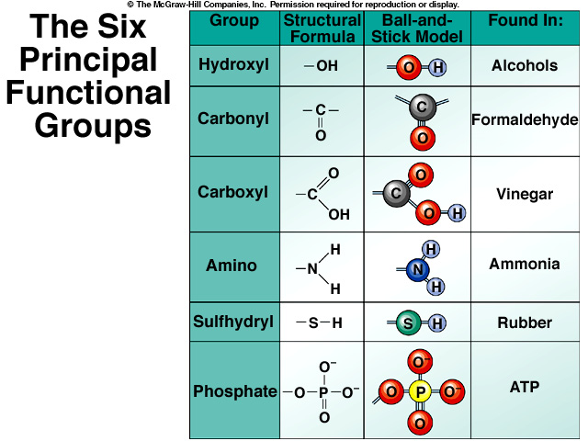
Not in text

Slide 26
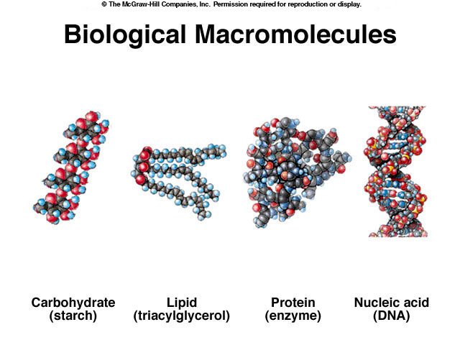
Four Main Types of Biomolecules (ball and stick models)
Not in text

Slide 27
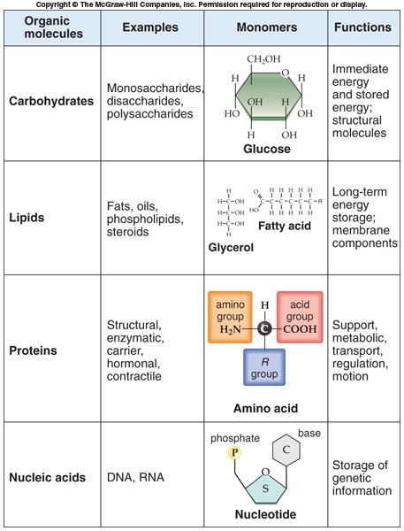
Summary Slide
Figure from p. 42

Slide 28
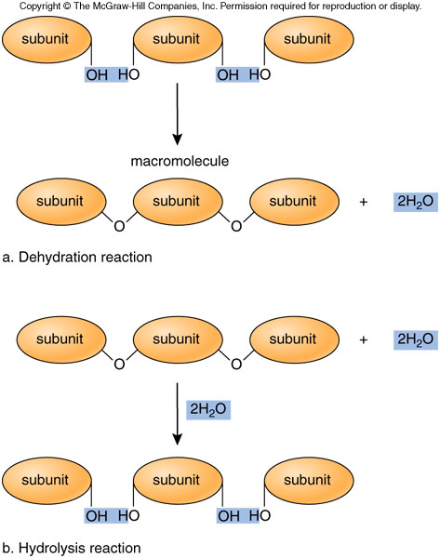
Similar to Figure 2.11

Slide 29
Carbohydrates
Complex sugars
General Formula (CH₂O)_{n}
Carbohydrate = “carbon plus water”
Make up the structural framework of cells
Play a critical role in energy storage

Slide 30
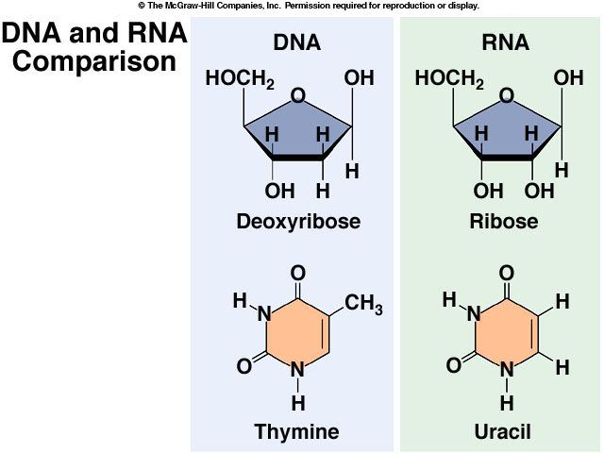
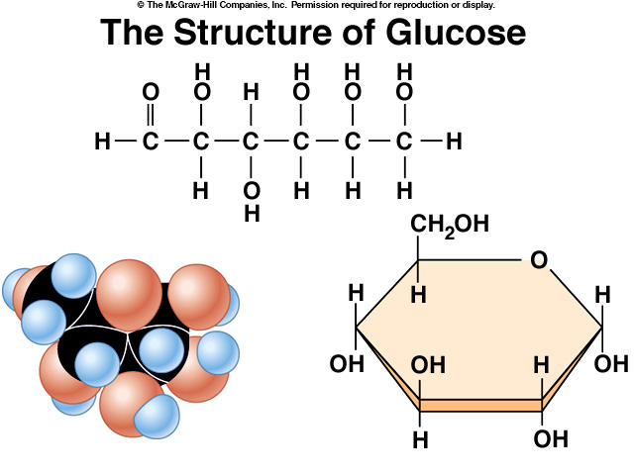
Simple Sugars: Monosaccharides
Monomers: Include 5-6 carbon atoms
-heterocyclic
2 Types:
1. Pentose: 5-membered ring
eg. ribose & deoxyribose
2. Hexose: 6-membered ring
eg. glucose
Building Blocks of Complex Carbohydrates
Not in text
Glucose
Not in text

Slide 31
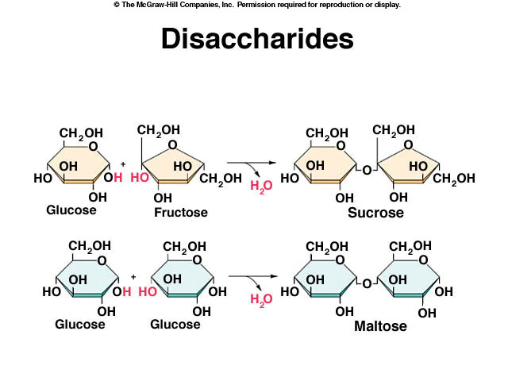
Simple Sugars: Disaccharides
Two monosaccharides linked together via a glycosidic bond form a disaccharide.
Dehydration Reaction (Condensation Polymerization)
Similar to Figure 2.12

Slide 32
Complex Carbohydrates: Polysaccharides
Polymers of monosaccharides
Can link together in different ways via a glycosidic bond to form complex carbohydrates
3 polymers of Glucose
Glycogen - linear strand w/ branching; found in animals
Starch- linear strand/ no branching; found in plants
Cellulose- linear strand/ no branching/ stacked/ found in plants, algae, bacteria

Slide 33
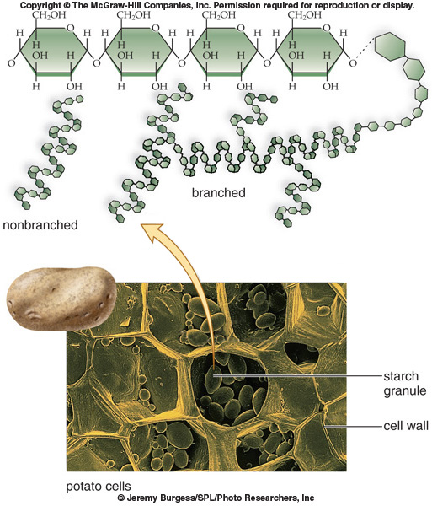
Starch
Figure 2.13

Slide 34
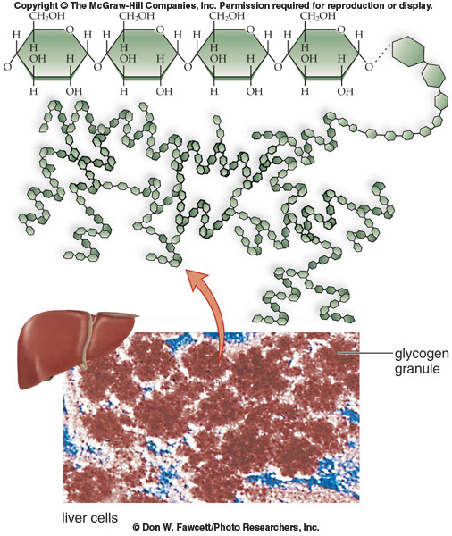
Glycogen
Figure 2.14

Slide 35
LIPIDS
Important for long-term energy storage
Excess glucose gets converted into fats
Insoluble in water
Contain long, nonpolar hydrocarbon chains
Types of Lipids:
Fats - most common (aka triglycerides)
Oils
Phospholipids
Steroids

Slide 36
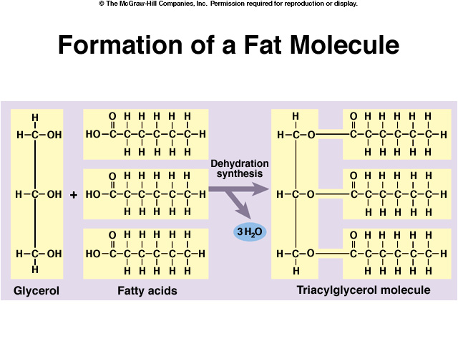
Glycerol + 3 Fatty acids Triglyceride + 3 H₂O
-Fatty acids vary in:
the length of the hydrocarbon chain and the saturation
Figure 2.16

Slide 37
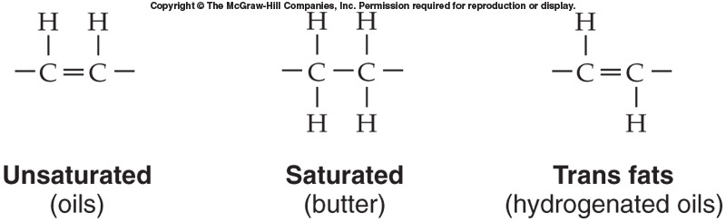
Comparison of Fat Types
Figure 2.17

Slide 38
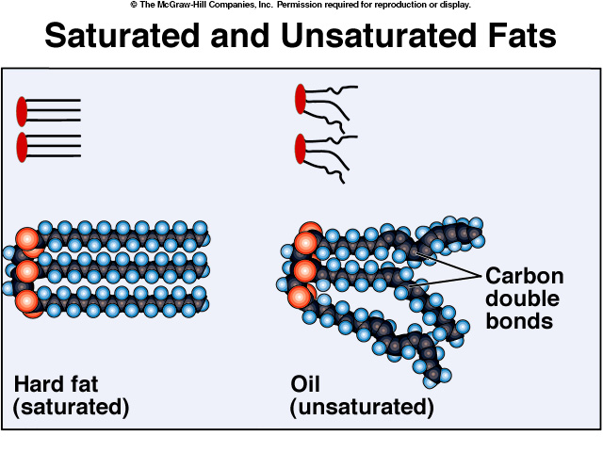
Figure not in text

Slide 39
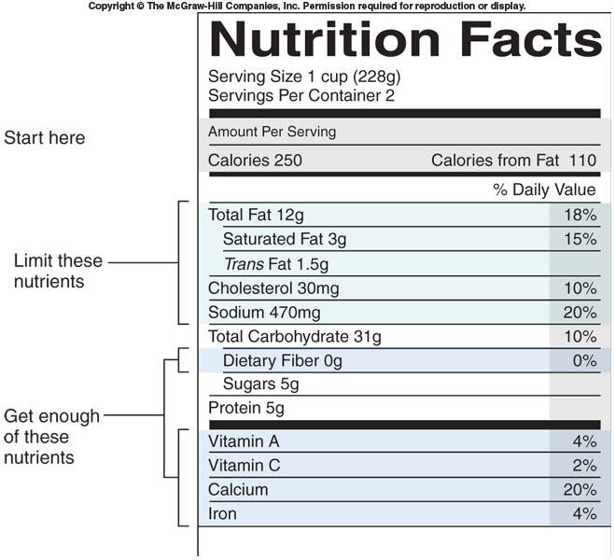
Figure 2.18

Slide 40
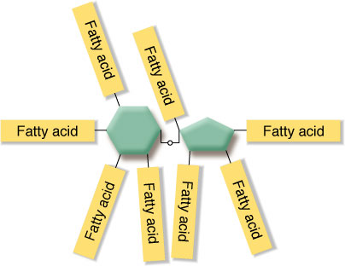
Lipids in the Diet
Fat substitutes
Not the same in composition as natural lipids
Olestra
A paint additive
Sucrose + fatty acids
Indigestible – provides zero kcals
Reduces absorption of fat-soluble vitamins (A,D,E,K)
Causes diarrhea
http://healthnews.uc.edu/news/?/24281/
Figure not in text

Slide 41
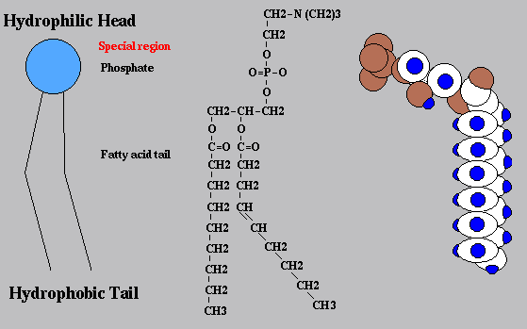
Phospholipids
Contain glycerol + 2 fatty acids + phosphate group
Polar head (hydrophilic) and nonpolar tail (hydrophobic)
Form Lipid Bilayer - make up all membranes
Similar to Figure 2.19

Slide 42
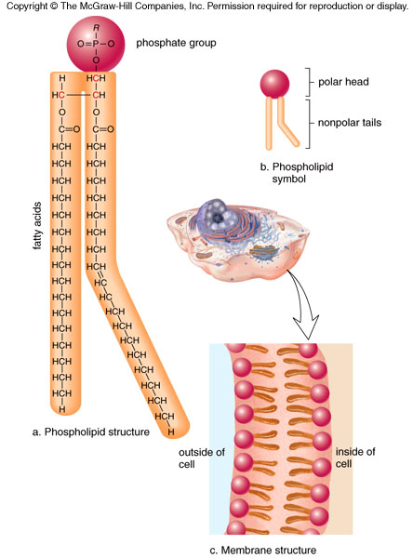
Similar to Figure 2.19

Slide 43
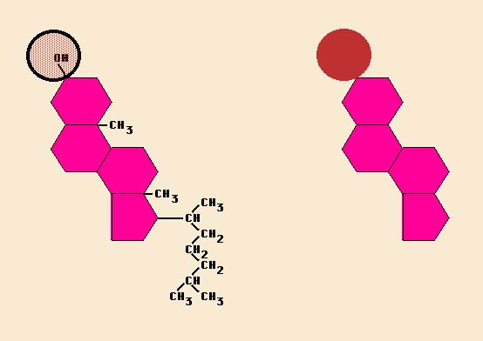
Steroids
Composed of 4-fused carbon rings
Functions:
Cellular components, contraceptives, muscle-mass enhancers, abortive agents
Examples:
Cholesterol - important in biological membranes
Estradiol & Testosterone - regulation of secondary sexual characteristics
Cholic acid & Bile salts - digestion of fat
Progesterone - reproduction
Molecular Framework:
“three rooms & a garage”
Similar to Figure 2.20

Slide 44
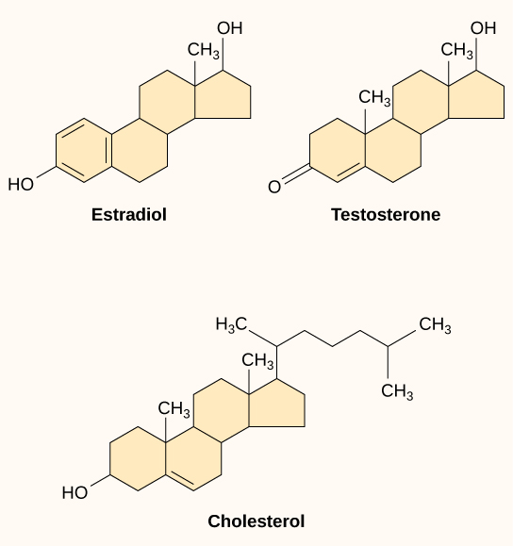
Sex Steroids
Similar to Figure 2.20

Slide 45
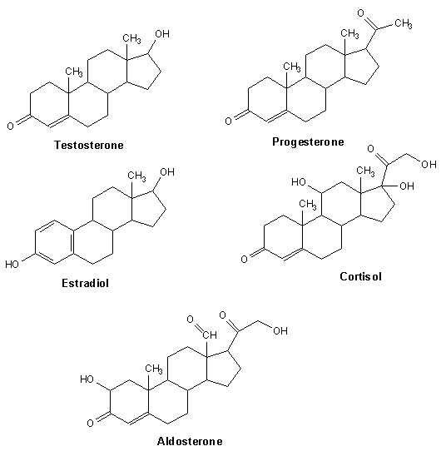
Steroids
Figure not in text

Slide 46
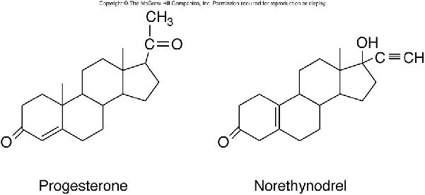
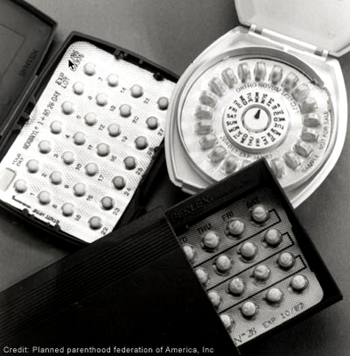
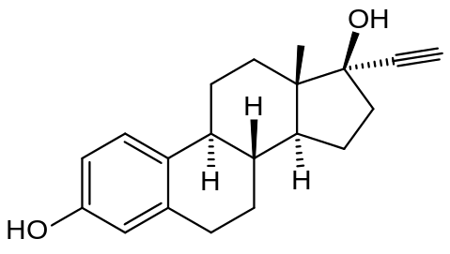
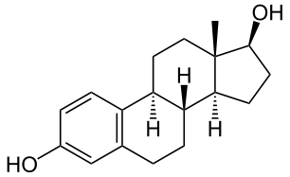
“The Pill”
Estradiol
Ethynyl Estradiol
Norethynodrel - active ingredient in Enovid - 1960
(the first commercially available oral conceptive)
Figure not in text

Slide 47
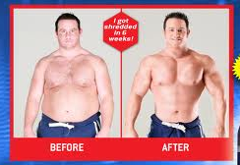
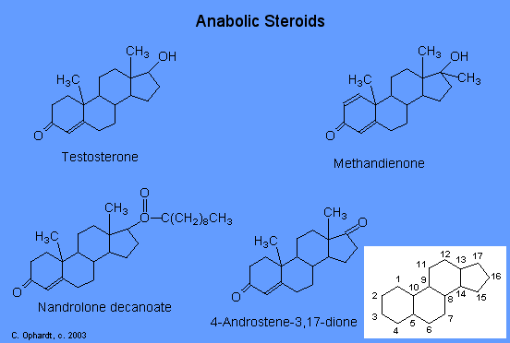
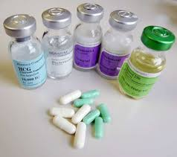
Anabolic Steroids
Figures not in text

Slide 48
PROTEINS
Roles in Biological Systems
Enzymes - catalyze biological reactions
Structural proteins - collagen, keratin, silk
Chemical messengers
Cell receptors - transmembrane proteins
Antibodies
Polymers of amino acids

Slide 49
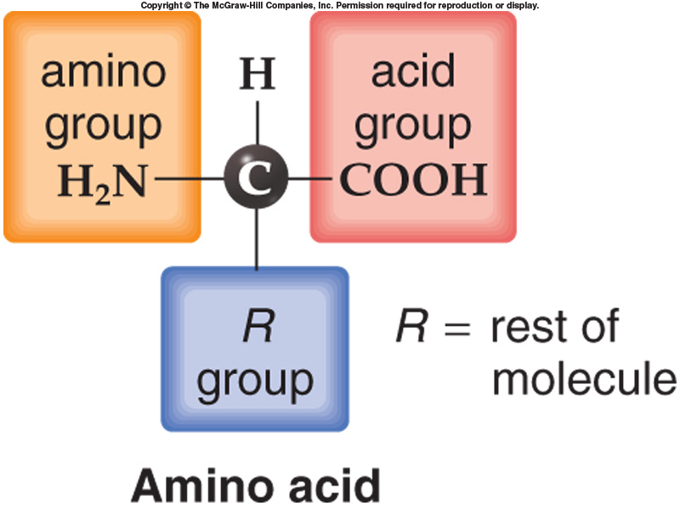
Figure 2.20b

Slide 50
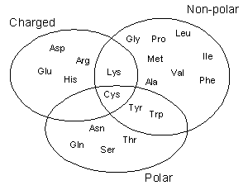
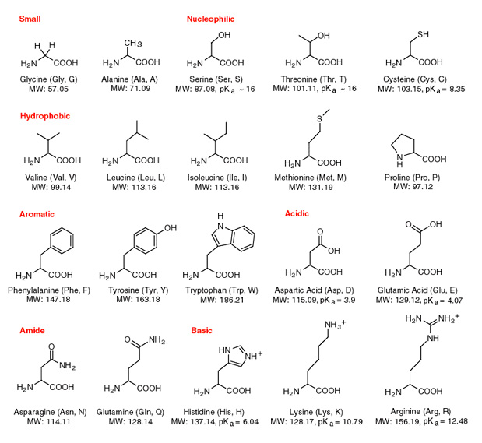
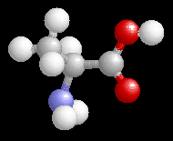
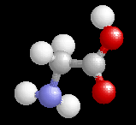
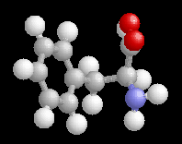
20 Common Amino Acids
Glycine (Gly)
Alanine (Ala)
Phenylalanine (Phe)
Figures not in text

Slide 51
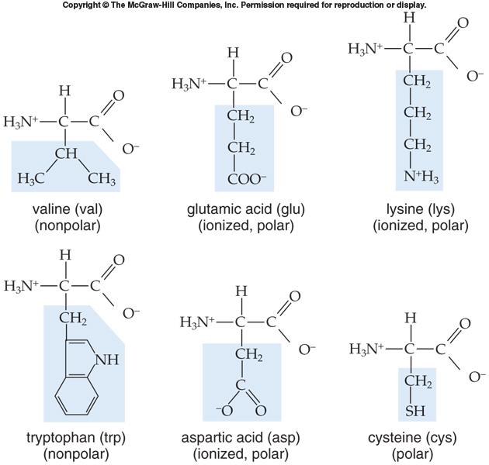
Figure 2.21

Slide 52
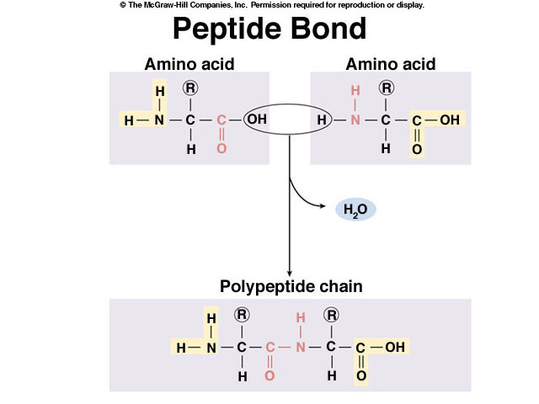
Figure similar to 2.22

Slide 53
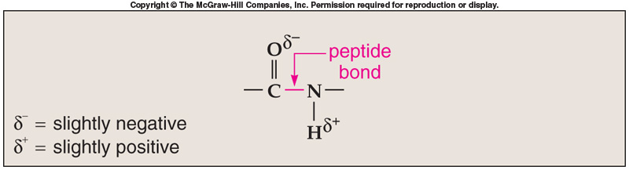
The Peptide Bond
Figure 2.22b

Slide 54
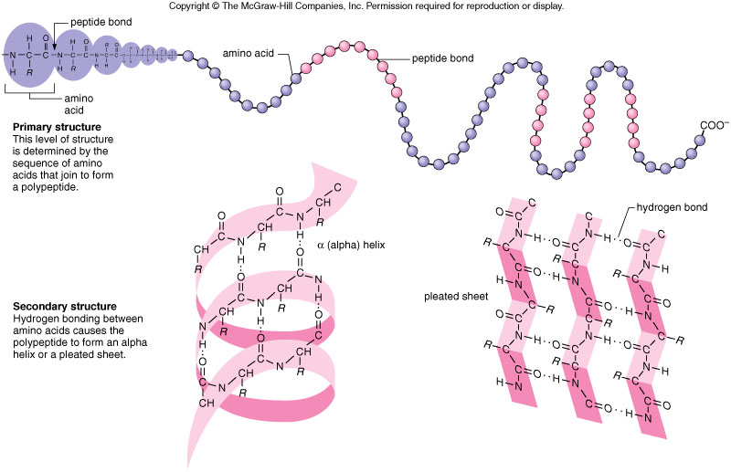
Figure 2.16a
Figure 2.23

Slide 55
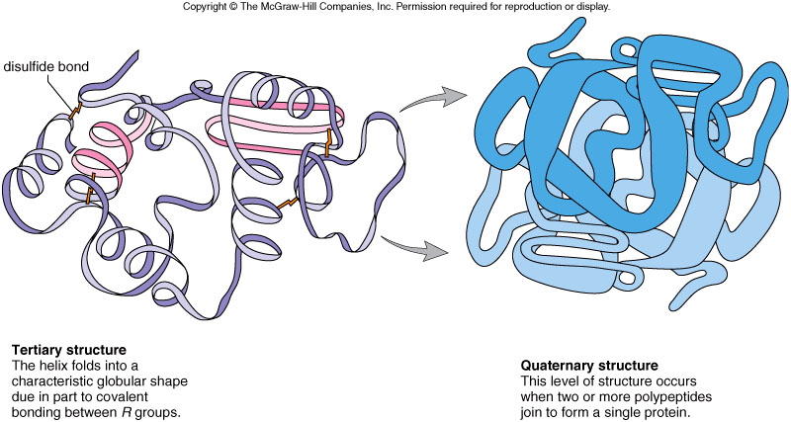
Figure 2.16b
Figure 2.23

Slide 56

Introducing the Nutrients
Food = mixture of chemicals
Nutrients = essential chemicals
6 classes of nutrients
Figures not in text

Slide 57
Introducing the Nutrients
General functions of nutrients
Supply energy
Carbohydrates, lipids, proteins
Contribute to cell and body structure
Regulate body processes

Slide 58

Introducing the Nutrients
Energy in foods
Measured in kilocalories (kcal)
Figures not in text

Slide 59

The Old Food Pyramid
Figures not in text

Slide 60

The New Food Pyramid
Figures not in text

Slide 61

What’s trending NOW

Slide 62
Nucleic Acids
Function
Genetic information storage (DNA, RNA)
Chemical messengers (cAMP)
Energy currency of cell (ATP)
Polymer of Nucleotides

Slide 63

Structure of a Nucleotide
Phosphate Group
Nitrogen Containing Base
Figure similar to 2.23b
Sugar

Slide 64

Nitrogenous Bases of Nucleotides
Figure similar to 2.24a

Slide 65
Sugar
Base
Figure similar to 2.24a

Slide 66

Phosphodiester Bond
sugar
base
phosphate
sugar
base
phosphate
sugar
base
phosphate
Figure similar to 2.24a

Slide 67

Figure 2.24a

Slide 68

The DNA Double Helix
Figure not in text

Slide 69


Structure of ATP
Figure 2.25

Slide 70

RNA
4 Types of RNA
mRNA
tRNA
rRNA
snRNA
single polynucleotide chains
ribose sugar
A U G C nucleotides
Figure 2.24a

Slide 71


Slide 72
Summary Slide
Figure from p. 42

